Slide 1


Accelerating Score-based Generative Models with Preconditioned Diffusion Sampling
Hengyuan Ma, Li Zhang, Xiatian Zhu, and Jianfeng Feng
Fudan University
University of Surrey

Slide 2
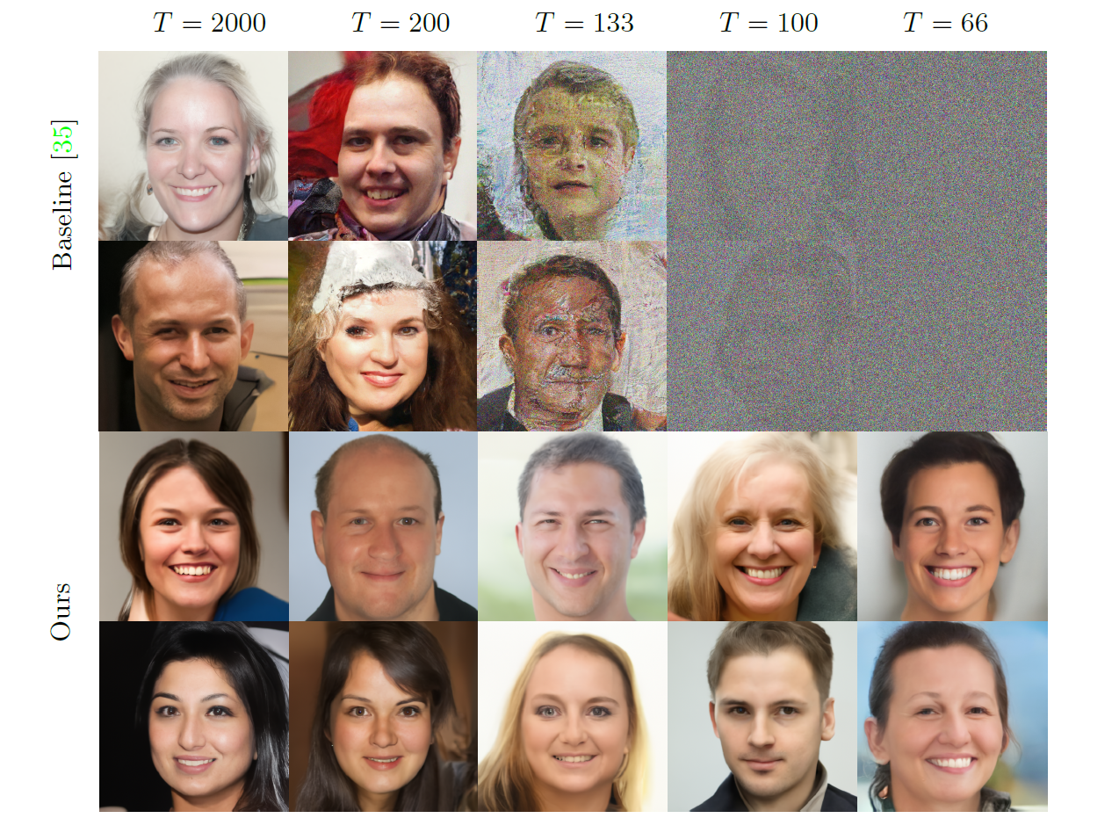
PDS accelerates SGMs on FFHQ (1024x1024)
[1]
NCSN++
Preconditioned Diffusion Sampling (PDS) accelerates the generating process of score-based generative models (SGMs)[1] while preserving the sample quality.
NCSN++ w/ PDS
[1] Song Y, Sohl-Dickstein J, Kingma D P, et al. Score-based generative modeling through stochastic differential equations. ICLR 2021.

Slide 3
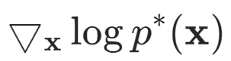
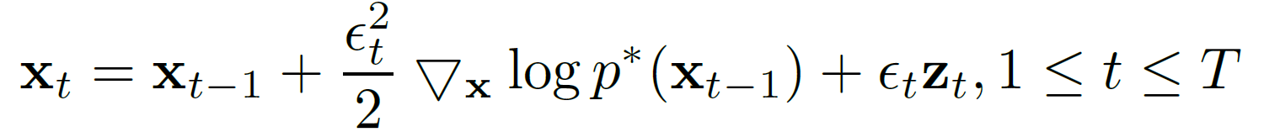
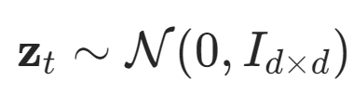
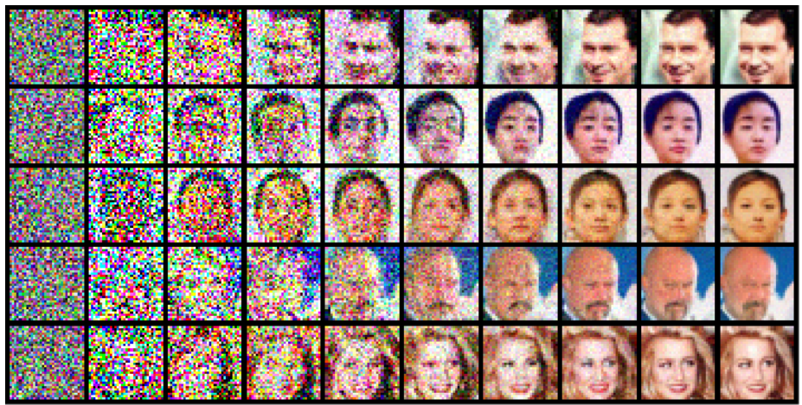
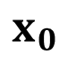
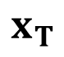
Score-based generative models (SGMs)
Denote the target distribution as $p^{∗}\left(x\right)$, the model is trained to fit the ‘score function’
through score matching. During inference, SGM iterates the following diffusion process
$$x_{0}$$
$$x_{T}$$

Slide 4
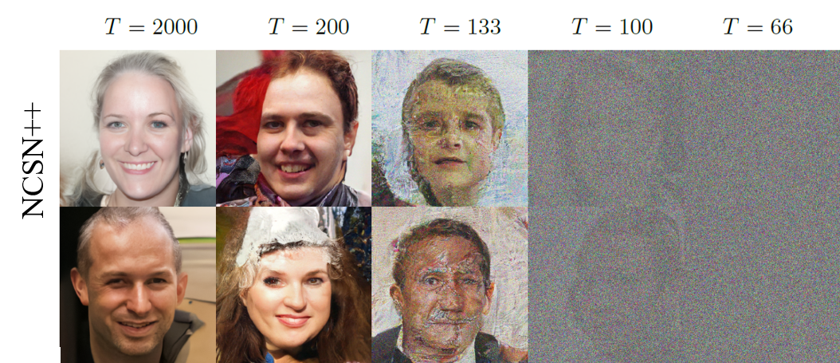
increasing steps size for higher speed
Failure examples

Slide 5
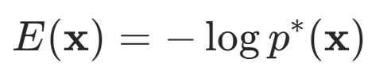
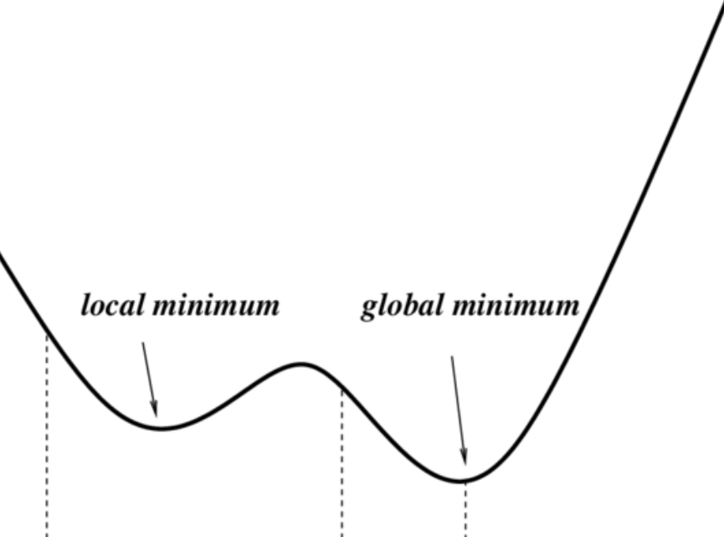
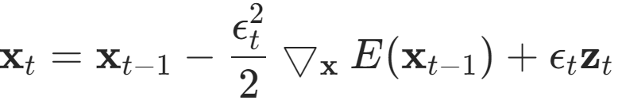
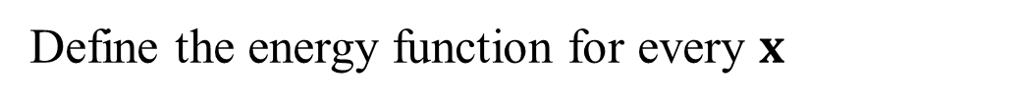
diffusion process as gradient descent (GD)
Define the energy function for every $x$
The diffusion process is reducing the energy using a GD with noise[2]
[2] Welling M, Teh Y W. Bayesian learning via stochastic gradient Langevin dynamics. ICML 2011.

Slide 6
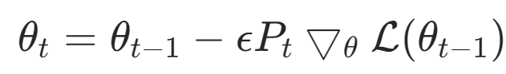
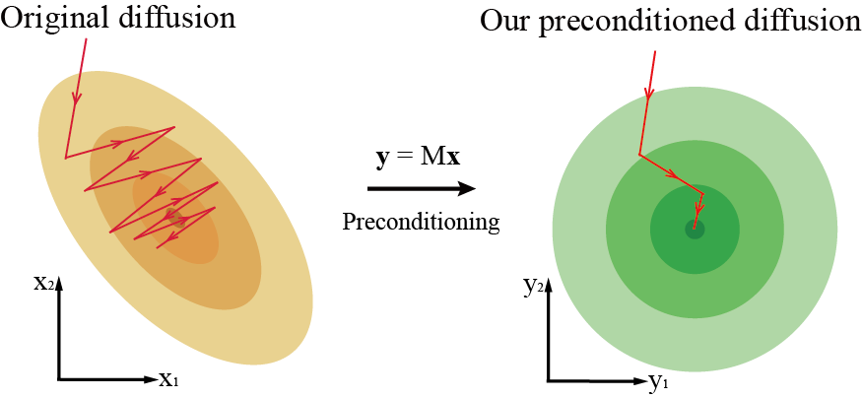
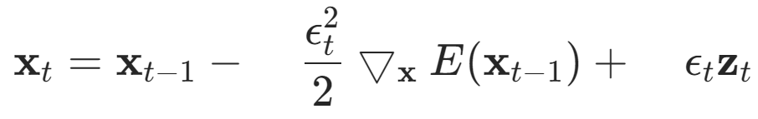
preconditioning GD and diffusion process
?
?

Slide 7
How to apply preconditioning while preserving the distribution of the generation images?

Slide 8
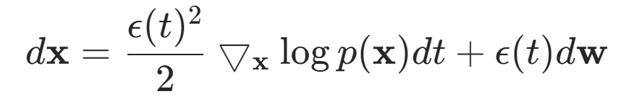
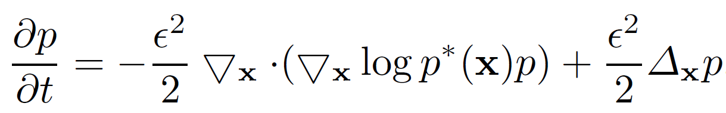
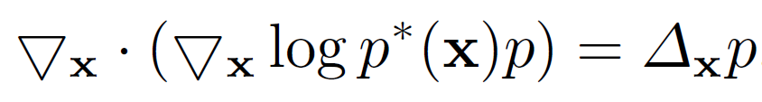
Fokker-Planck equation of the diffusion process
Under mild conditions, we can get a partial differential equation about the dynamics of the distribution function $p(x,t)$ [3].
Discrete diffusion process
Continuous diffusion process
Fokker-Planck equation
Set the L.H.S to 0, we get the steady state equation
As long as our alteration to the diffusion process does not change the steady state equation, the steady state distribution is unchanged.
[3] Gardiner C W. Handbook of stochastic methods[M]. Berlin: springer, 1985.
Notes:
Boundary condition

Slide 9
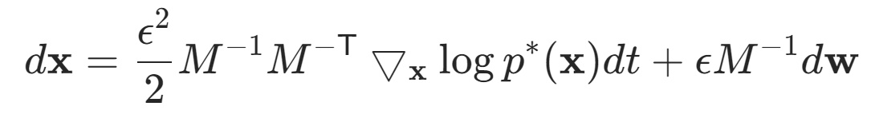
It can be verified that the following preconditioning keeps the steady state distribution unchanged.
How to choose the preconditioning matrix M?

Slide 10
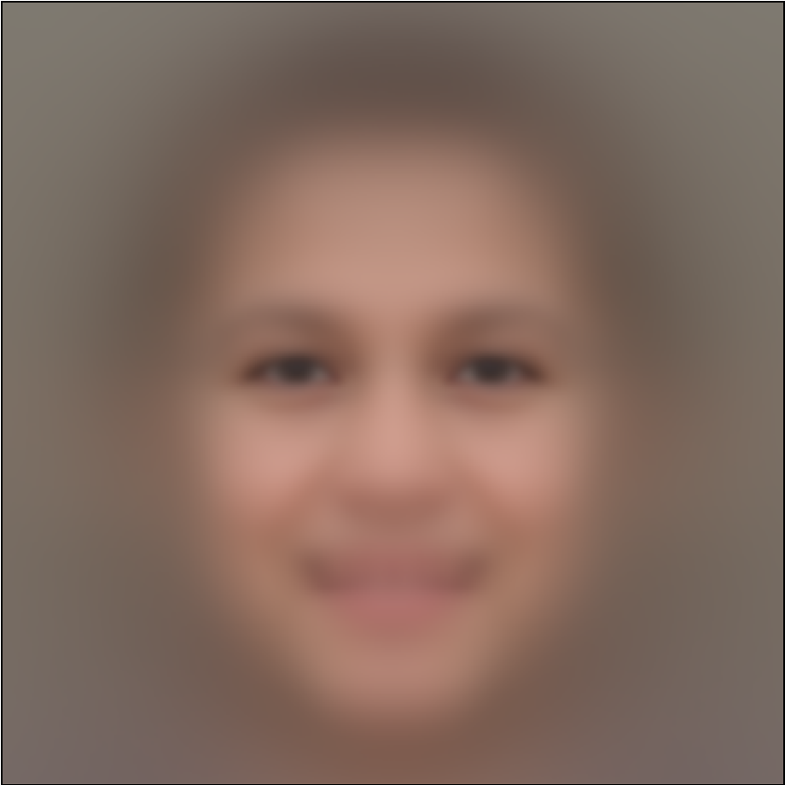
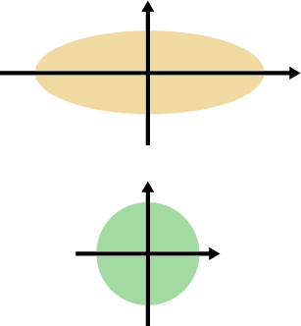
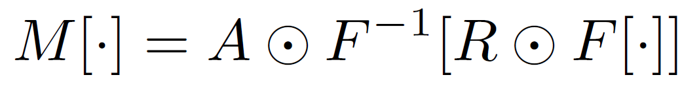
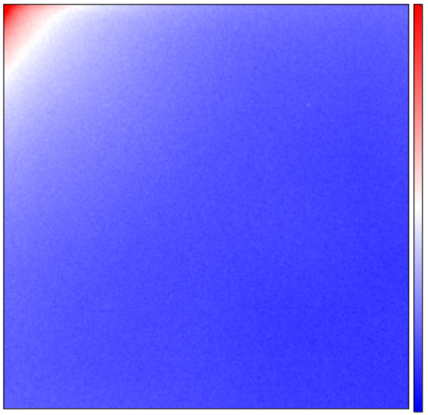
spatial statistics preconditions the pixel coordinates
mean face
low frequency
high frequency
high amplitude
low frequency
frequency statistics preconditions the frequency coordinates
high frequency
low amplitude
Notes:
频域相当于换了一个坐标系，在另一个坐标系的层面上进行preconditioning

Slide 11
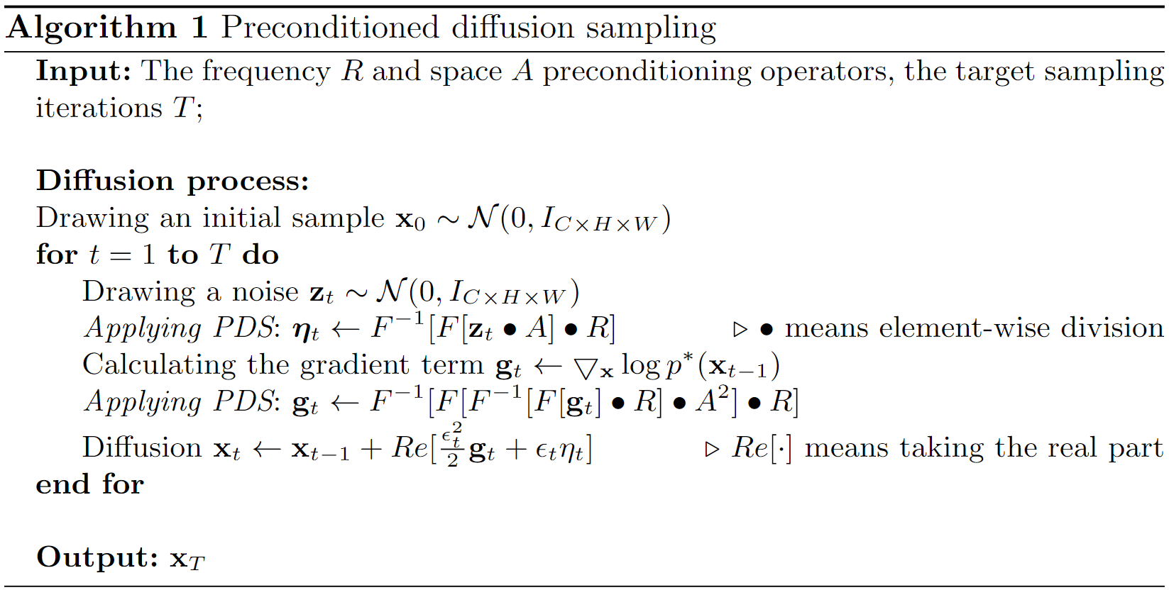
Its coordinates can be positively or negatively correlated

Slide 12
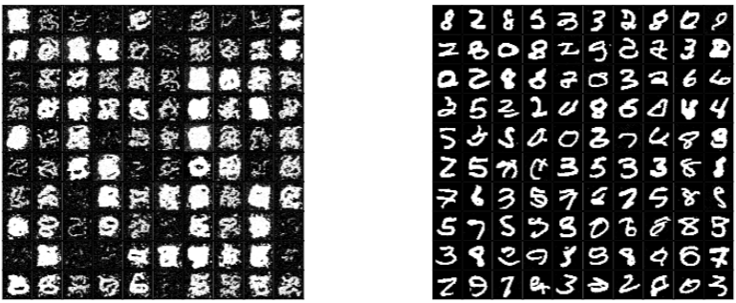
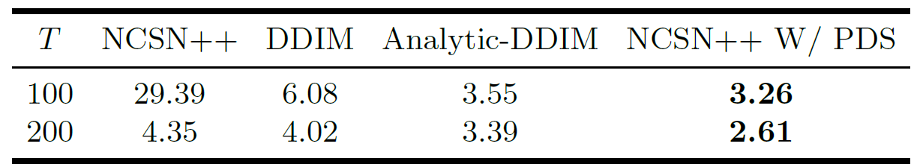
Results demonstration
MNIST
NCSN [4] (20 iterations)
NCSN w/ PDS (20 iterations)
CIFAR-10
[5]
[6]
FID
[4] Song Y, Ermon S. Generative modeling by estimating gradients of the data distribution. NeurIPS 2019.
[5] Song J, Meng C, Ermon S. Denoising diffusion implicit models. ICLR 2020.
[6] Bao F, Li C, Zhu J, et al. Analytic-dpm: an analytic estimate of the optimal reverse variance in diffusion probabilistic models. ICLR, 2022.

Slide 13
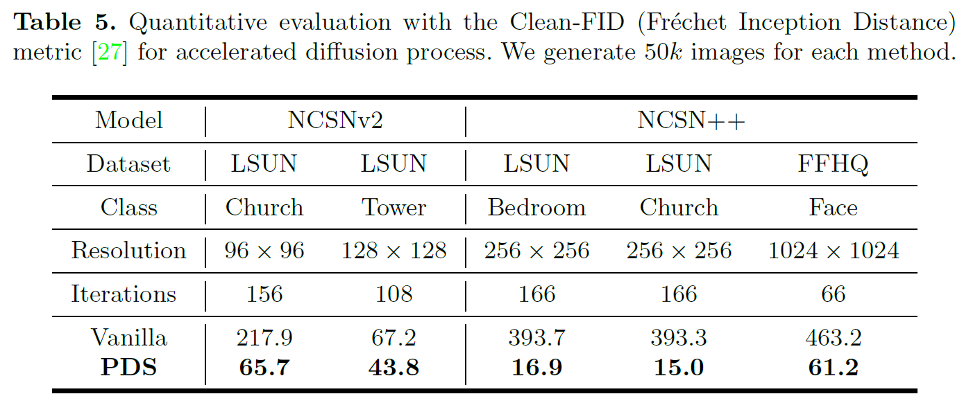
FID

Slide 14
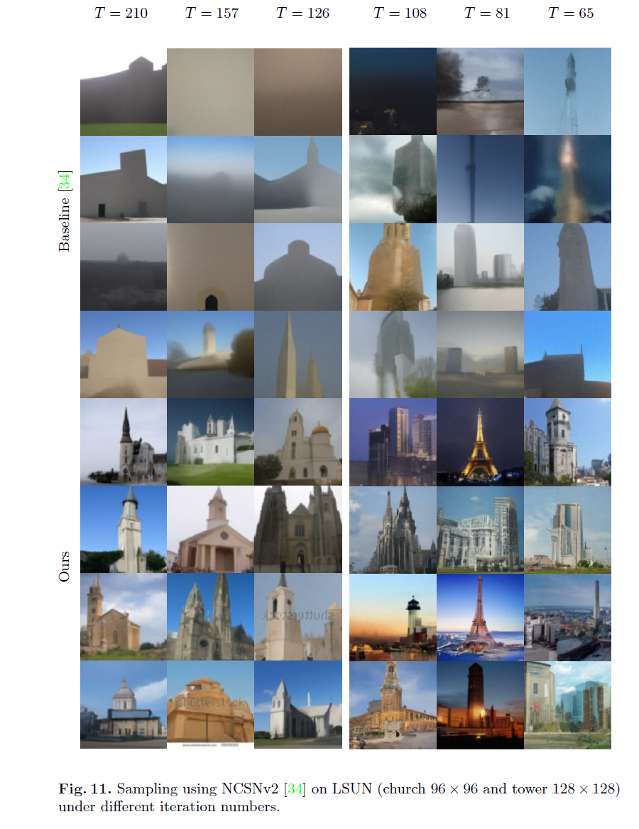
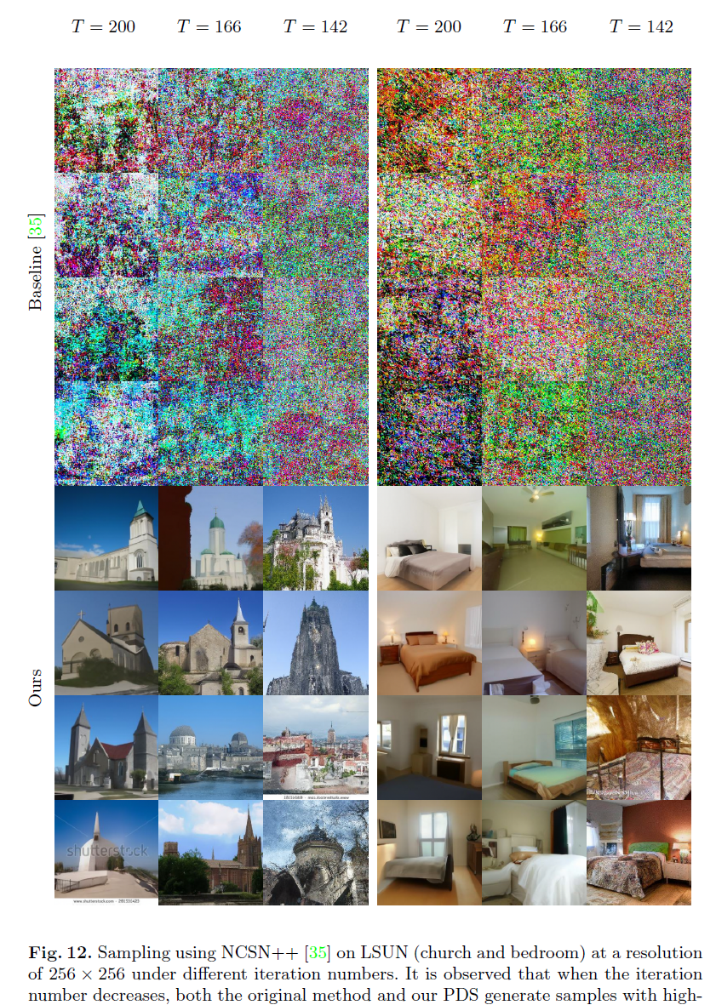

Slide 15
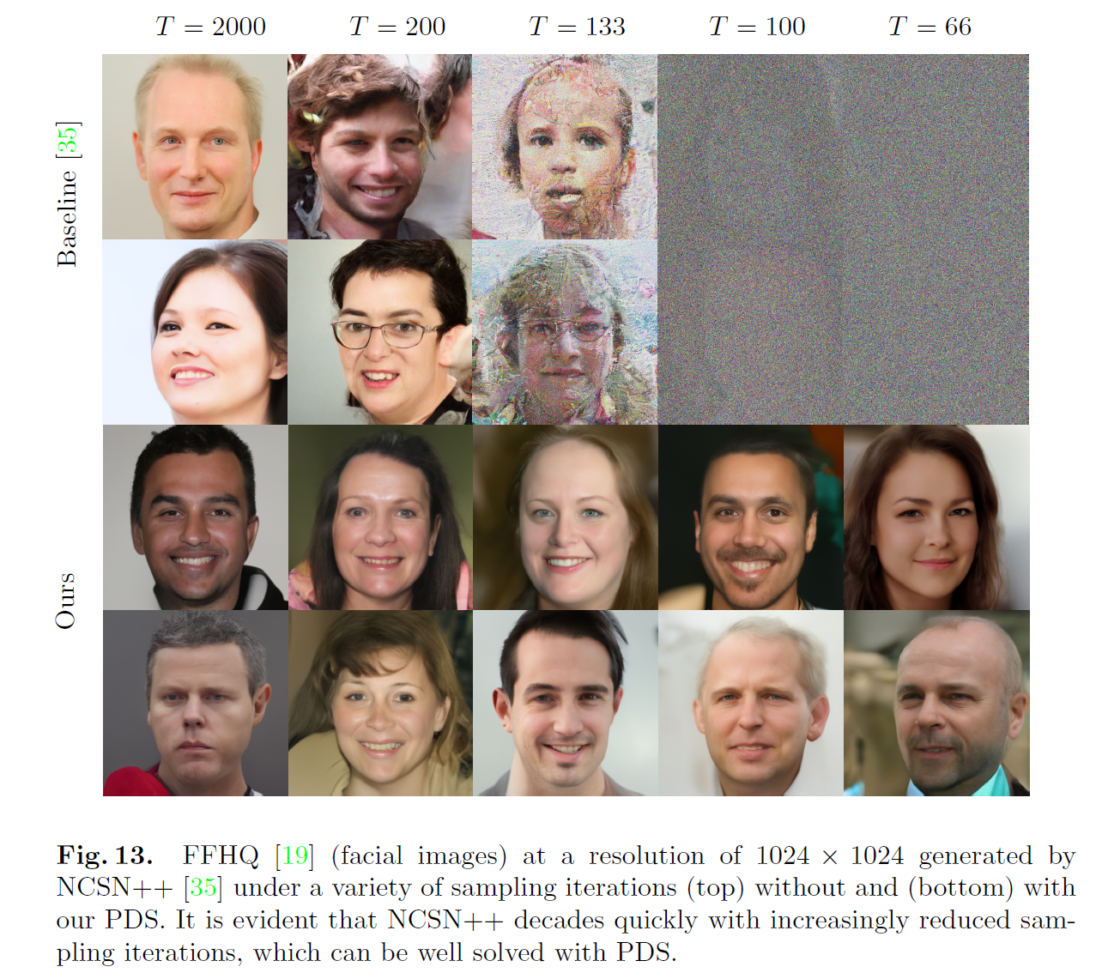

Slide 16

Thank you
Code released https://github.com/fudan-zvg/PDS

